Slide 1


Volatility Forecasting using AWS SageMaker
Feb 2023

Slide 2
Volatility Forecast
Machine learning workflow
Build
Train and tune
Deploy and manage
Code example

Slide 3
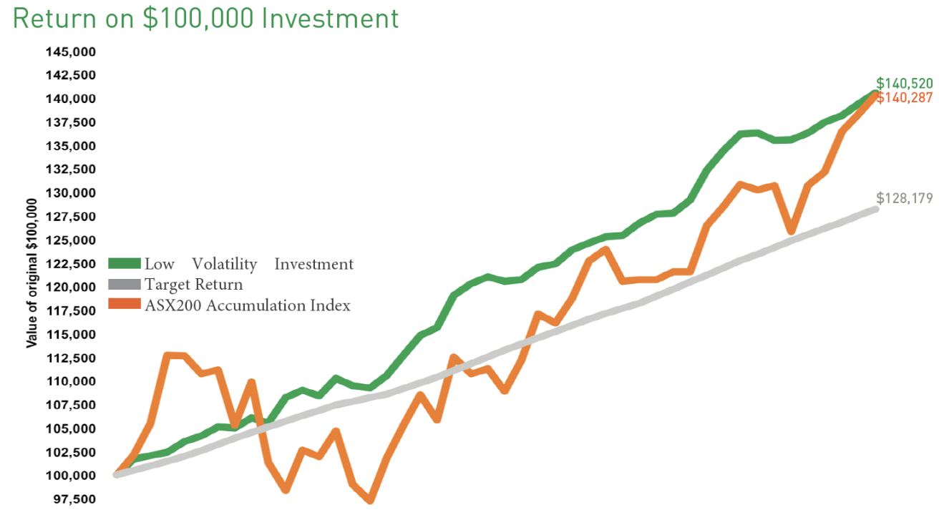
Volatility
Volatility is the range of price changes a security experiences over a given period
Standard deviation is the most common way to measure volatility
The CBOE Volatility Index (VIX) is a common metric used to measure the expected volatility of the S&P 500

Slide 4
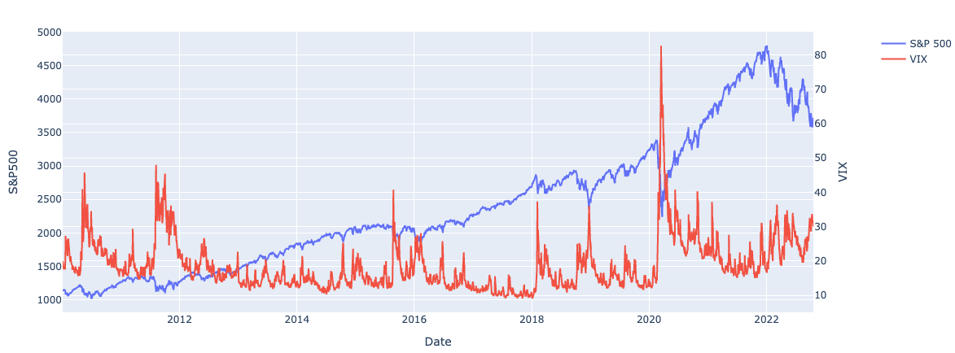
Volatility
Volatility is the range of price changes a security experiences over a given period
Standard deviation is the most common way to measure volatility
The CBOE Volatility Index (VIX) is a common metric used to measure the expected volatility of the S&P 500

Slide 5
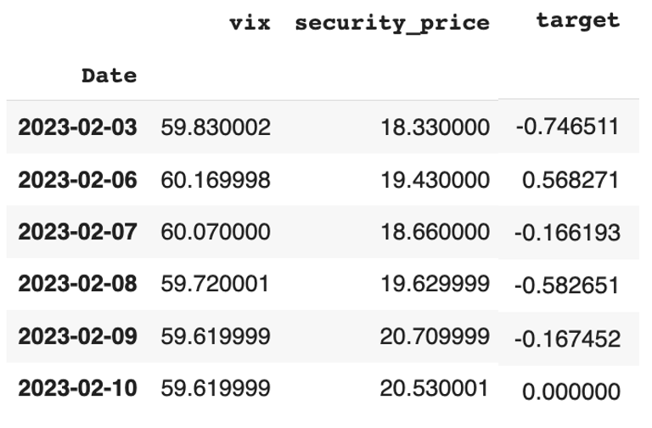
Volatility Forecast
Historical Price
Learning
Algorithm
Model
Prediction
VIX
Output
Input - new unseen data
Date Price
2023-02-13 30.12

Slide 6
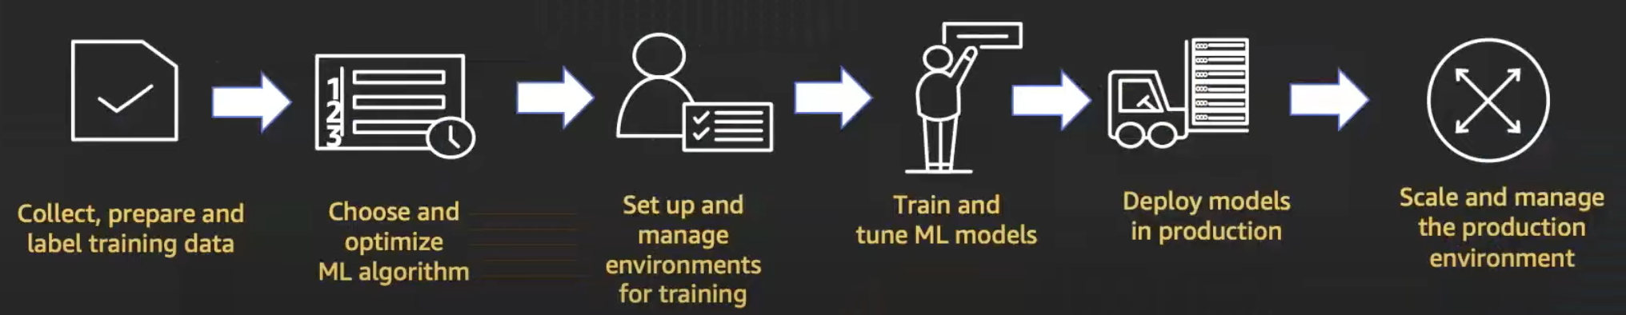
Machine Learning Process

Slide 7
Machine Learning Process
Build
Train
Deploy

Slide 8
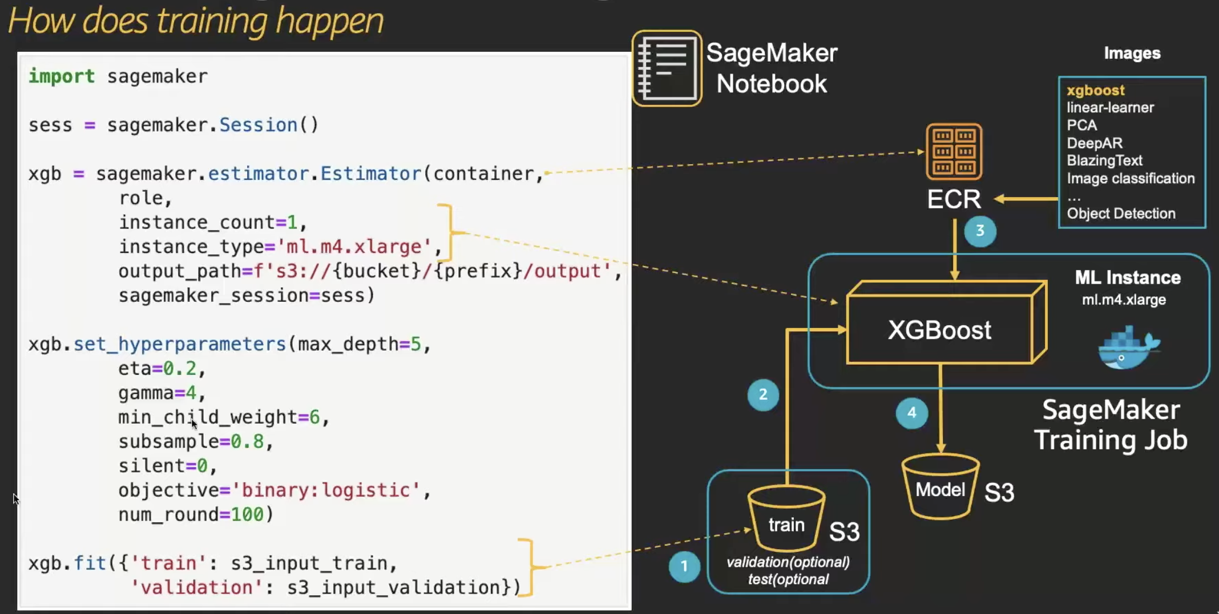
How does training happen
How does training happen

Slide 9
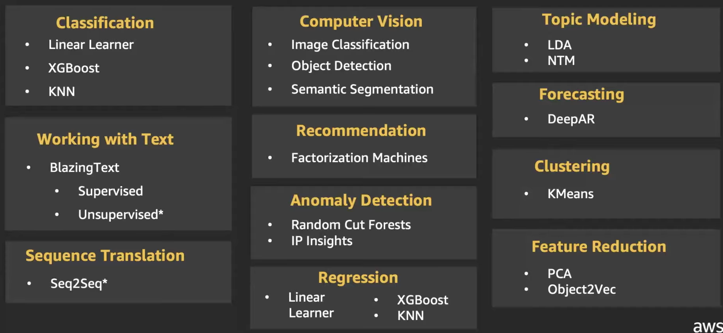

Built-in Algorithms

Slide 10
Demo
Notes:
Hyperparameters ( algorithm parameters that significantly affect model quality)
Decision Tree : tree depth, max leaf nodes, etc.
Neural Networks : number of layers, hidden layer width, learning rate, etc.
Metrics to measure performance

Slide 11
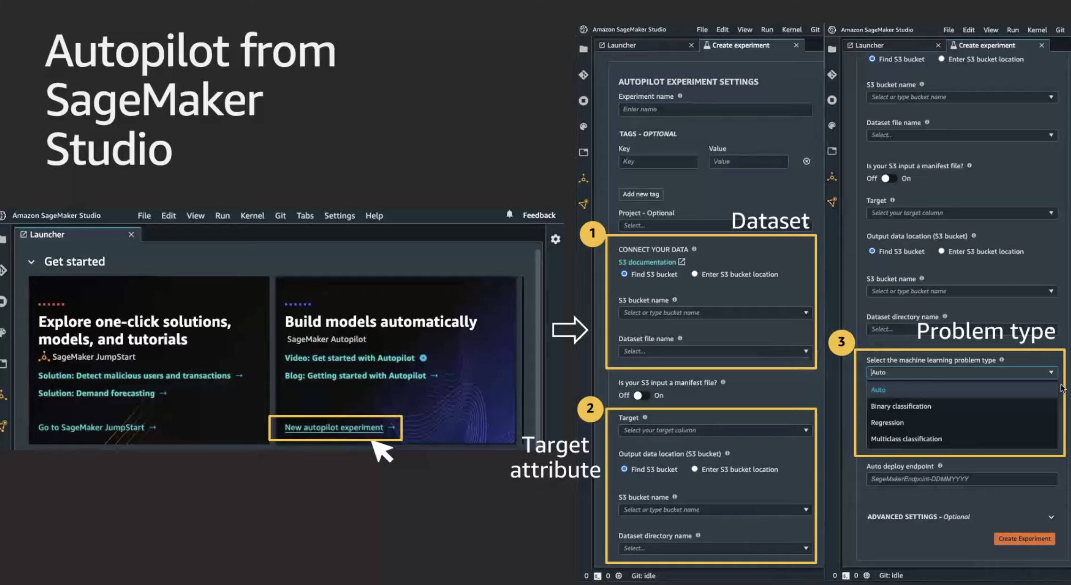
Autopilot

Slide 12
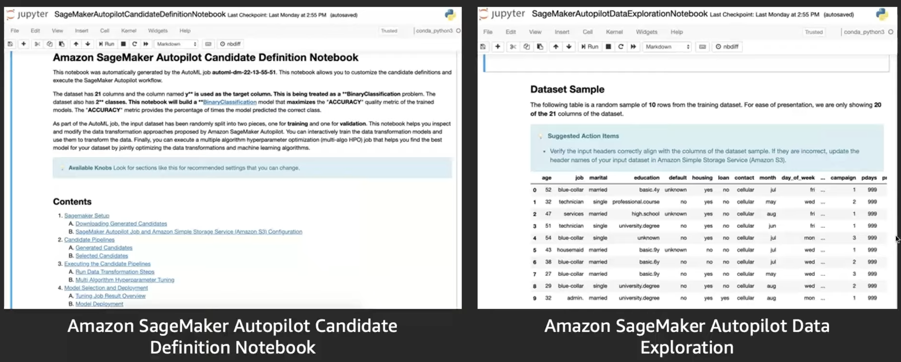
Autopilot

Slide 13
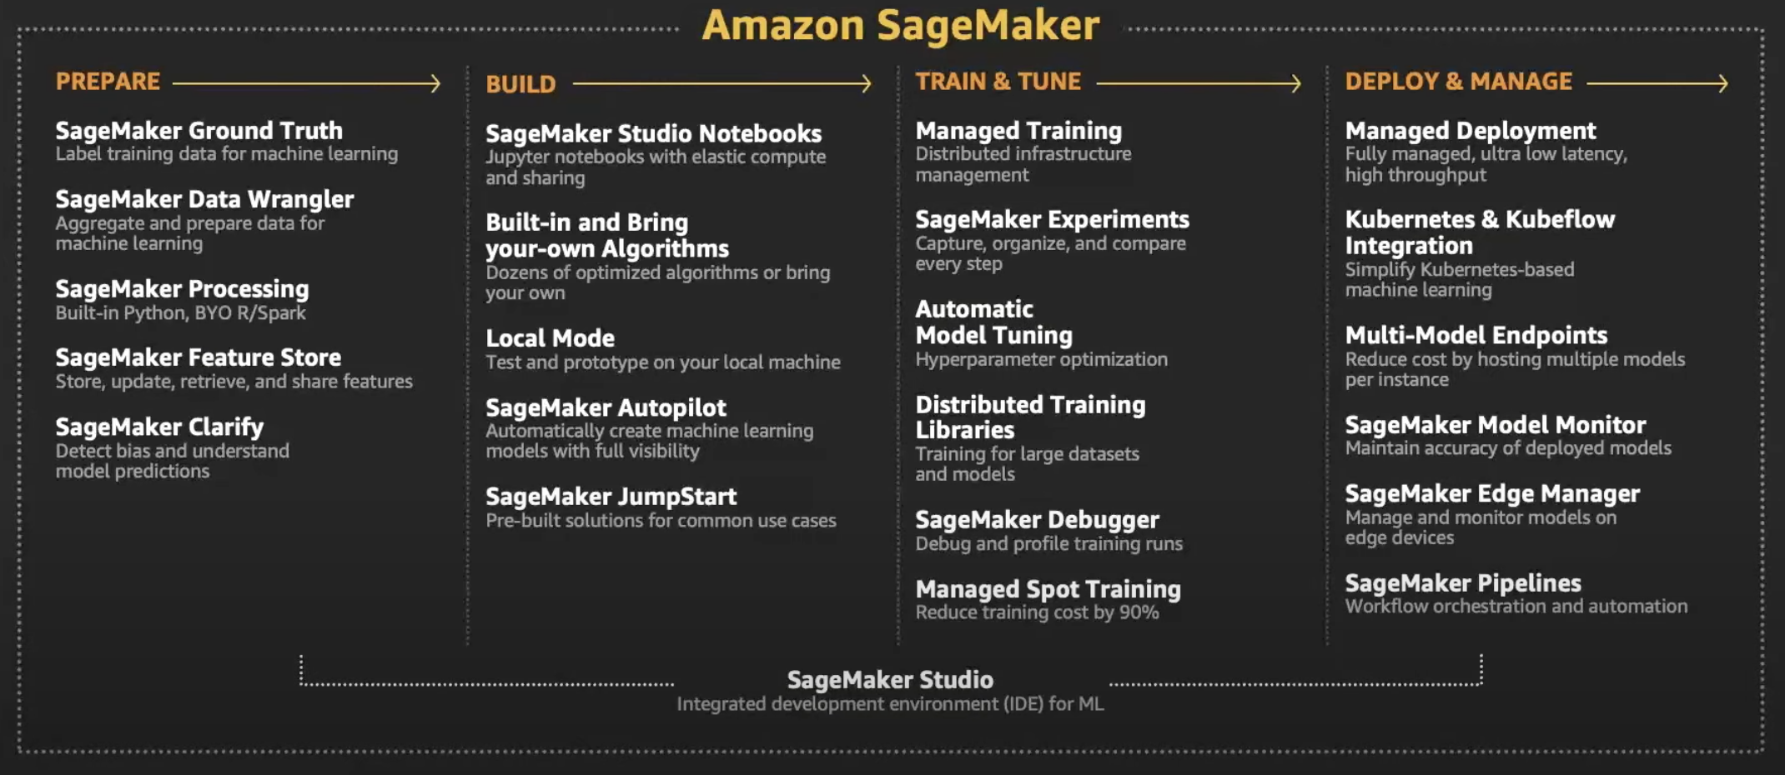
AWS SageMaker

Slide 14

AWS SageMaker

Slide 15
Thank you

Slide 16
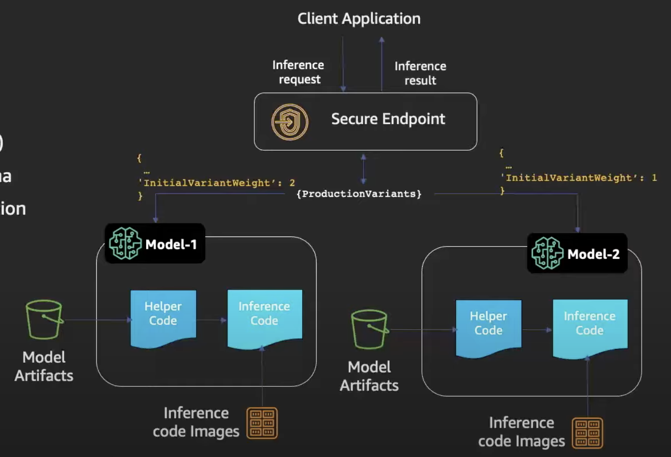
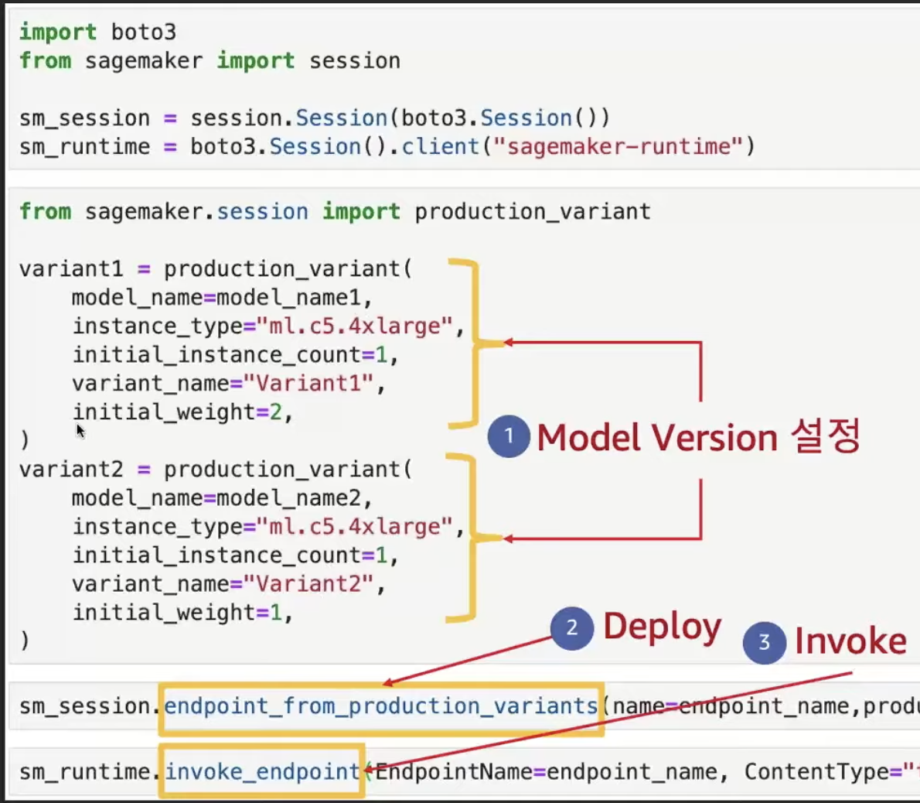
Updating endpoints – A/B Testing

Slide 17
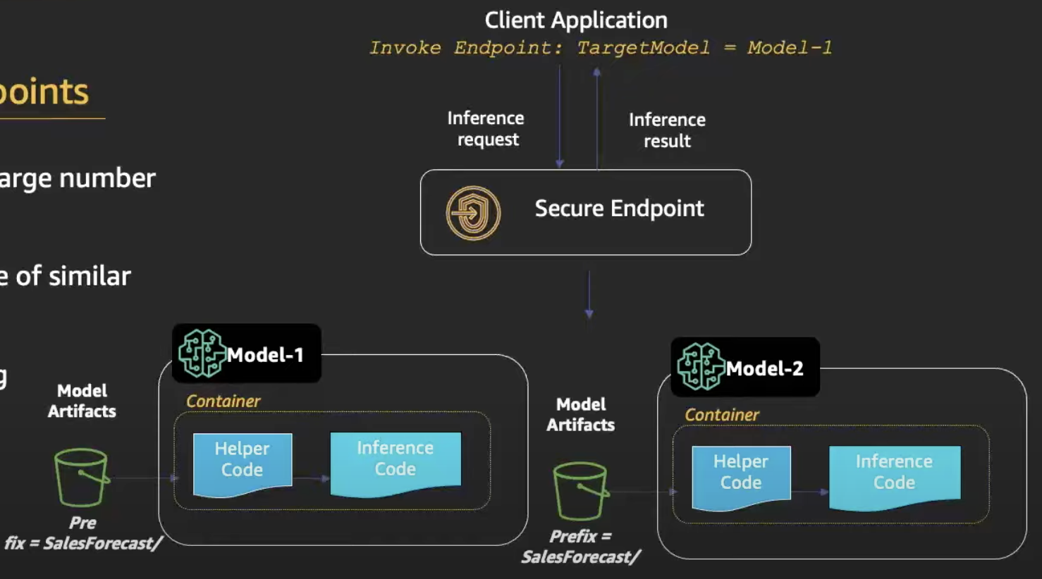
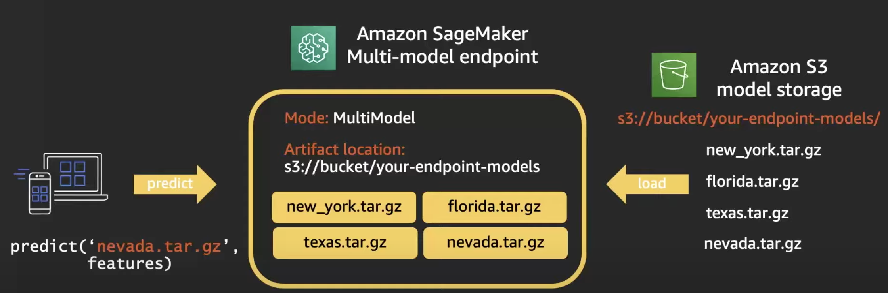
Updating endpoints – Multi-Model Endpoint

